Slide 1
Instructions
1. Click on an image and then hold down the control key and type c as you hold the
control key down. This will copy the image to the clipboard. Then paste it into
whatever application you want.
2. The image has a transparent background. However, the transparency works best
with a light background (preferably white). On dark backgrounds, the lettering
looks poor. Light blue, light gray, light yellow, light green, light orange, all work fine.
3. After pasting the image, you can re-size it by dragging the handles on it after
clicking it, as appropriate. In a few cases, I was unable to make the background
transparent without affecting the figure. I used a solid white background in this case.

Slide 2
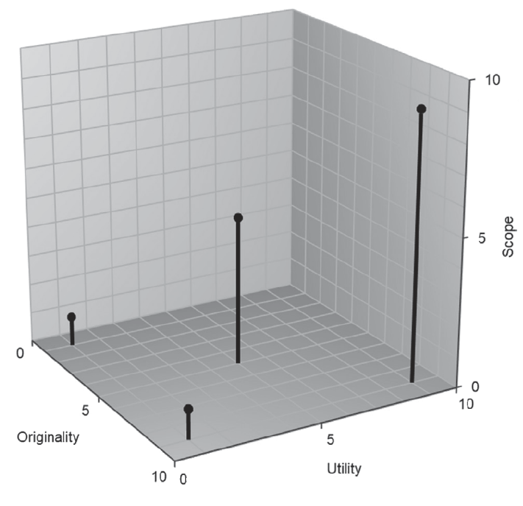
Figure 3.1: Originality, Utility and Scope

Slide 3
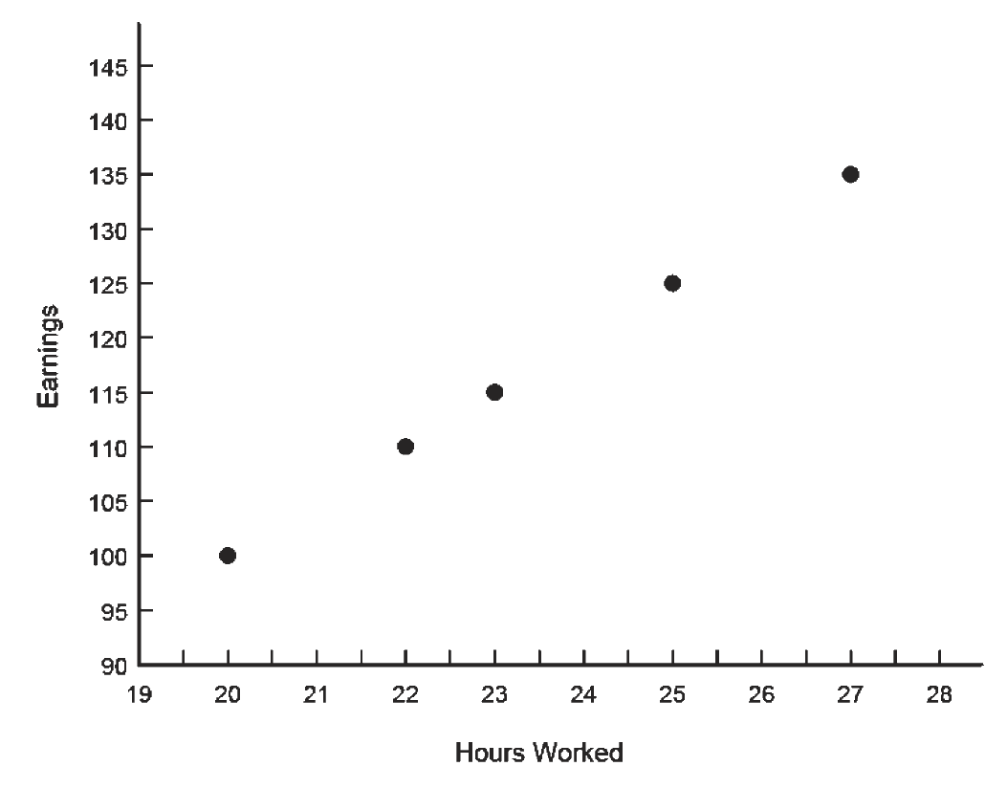
Figure 6.1: Scatterplot for Earnings as a Function of Hours Earned

Slide 4
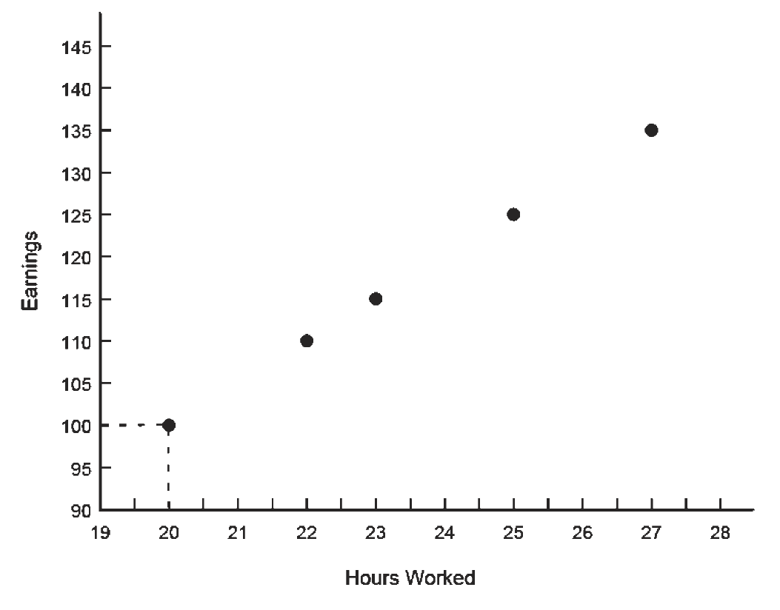
Figure 6.2: Scatterplot with Dotted Lines for Earnings as a Function of Hours Earned

Slide 5
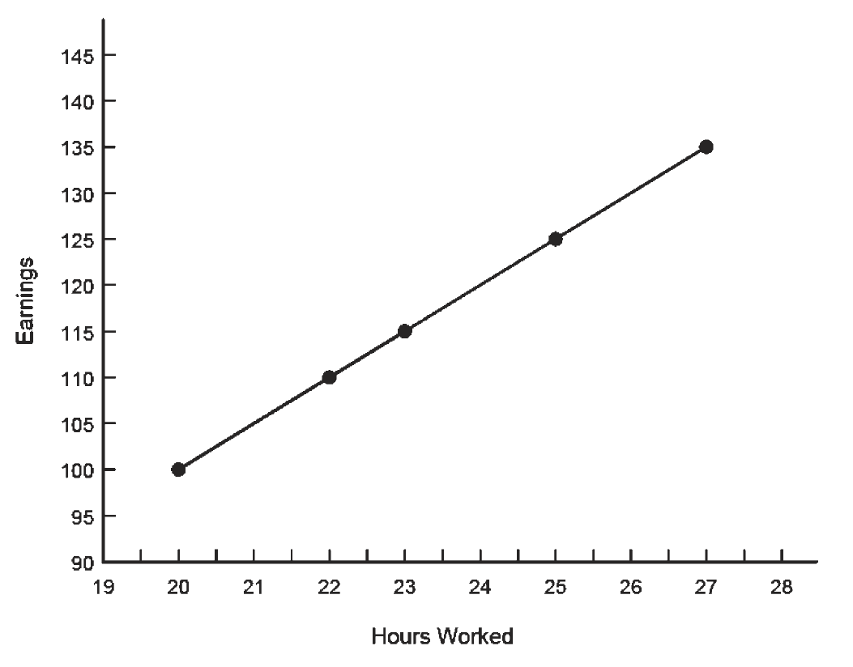
Figure 6.3: Scatterplot with Dots Connected for Earnings as a Function of Hours Earned

Slide 6
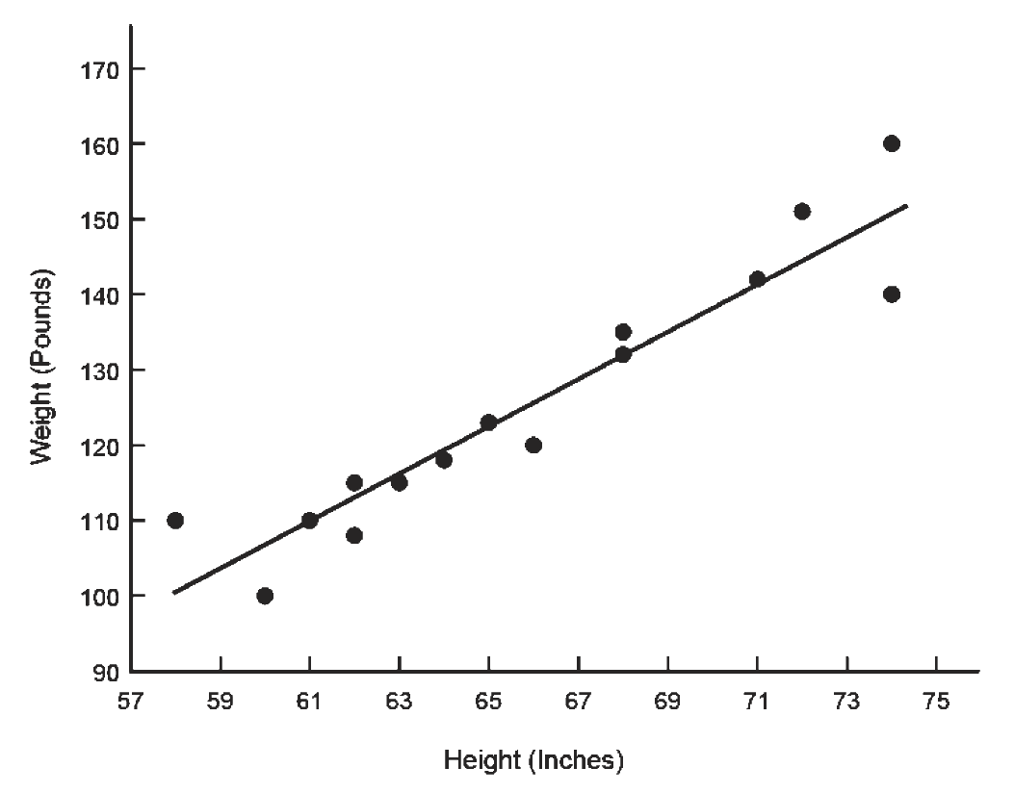
Figure 6.4: Scatterplot between Height and Weight

Slide 7
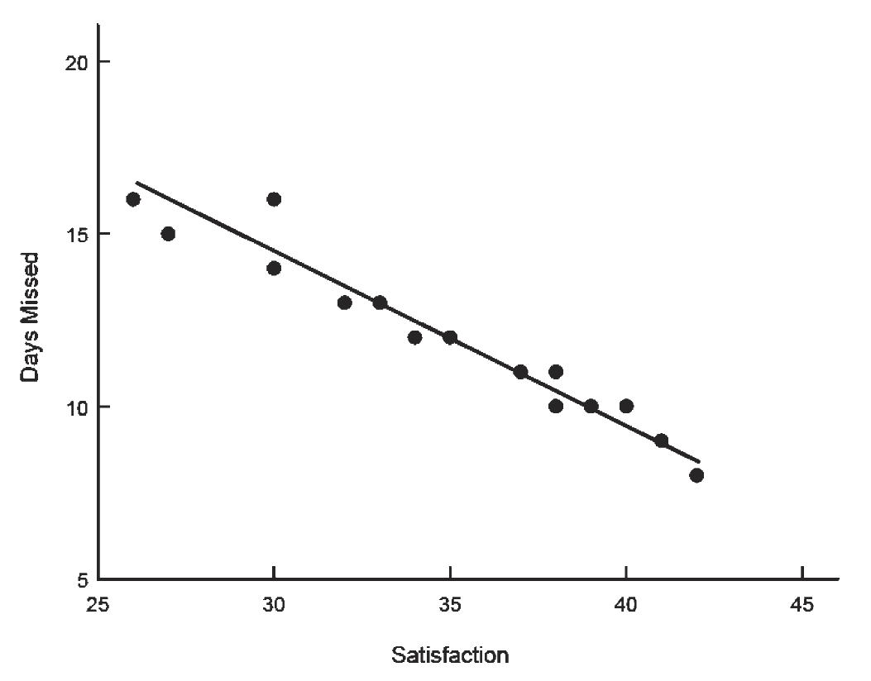
Figure 6.5: Example of an Inverse Relationship

Slide 8
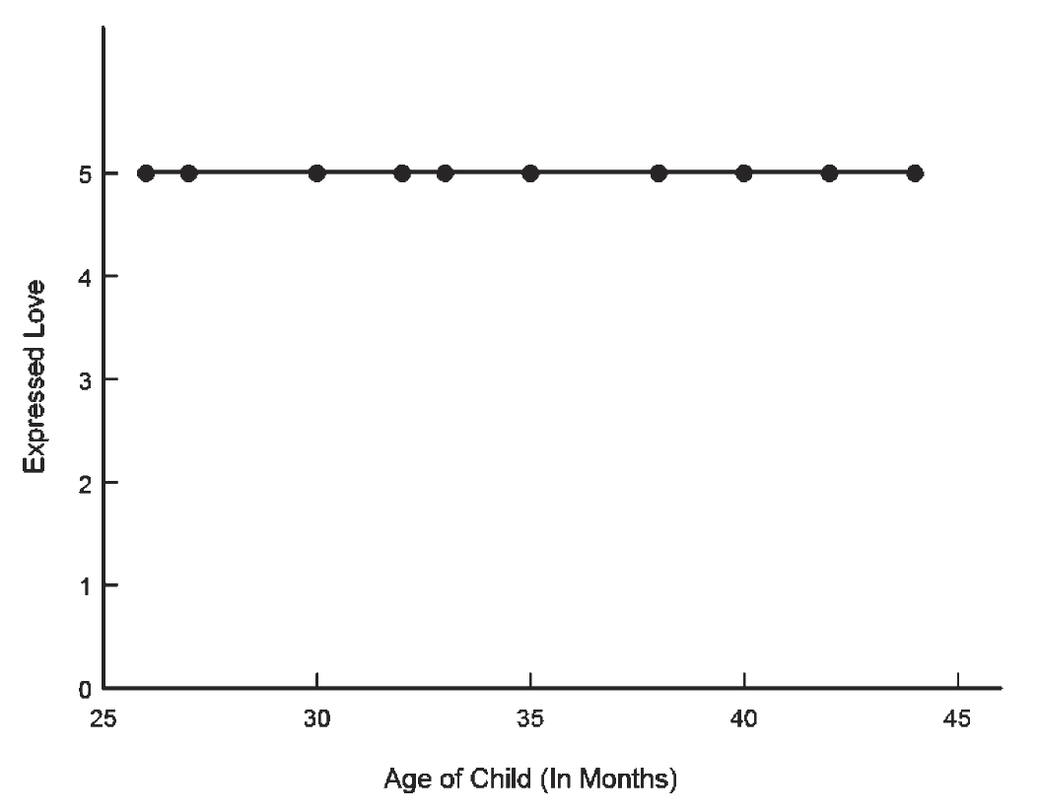
Figure 6.6: Example of a Zero Slope Relationship

Slide 9
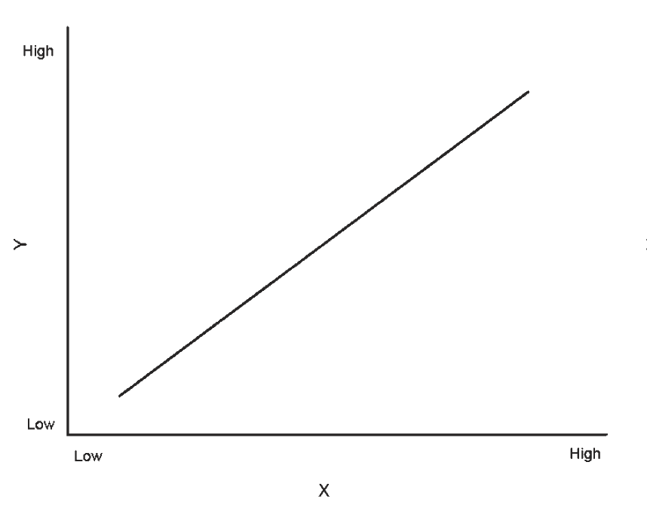
Figure 6.7a: Examples of Hypothetical Scatterplots: Direct Linear Relationship

Slide 10
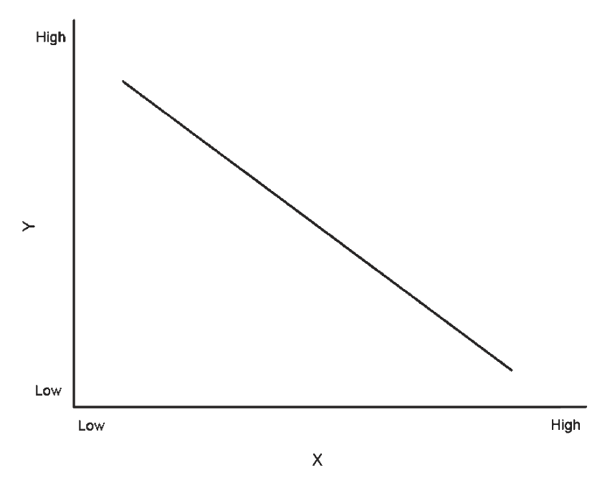
Figure 6.7b: Examples of Hypothetical Scatterplots: Inverse Linear Relationship

Slide 11
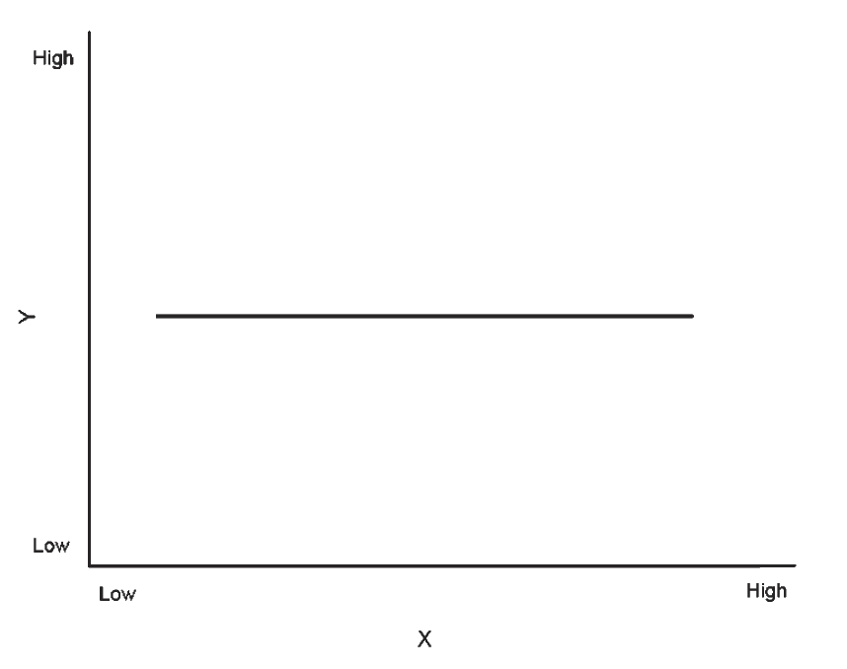
Figure 6.7c: Examples of Hypothetical Scatterplots: Zero Slope Relationship

Slide 12
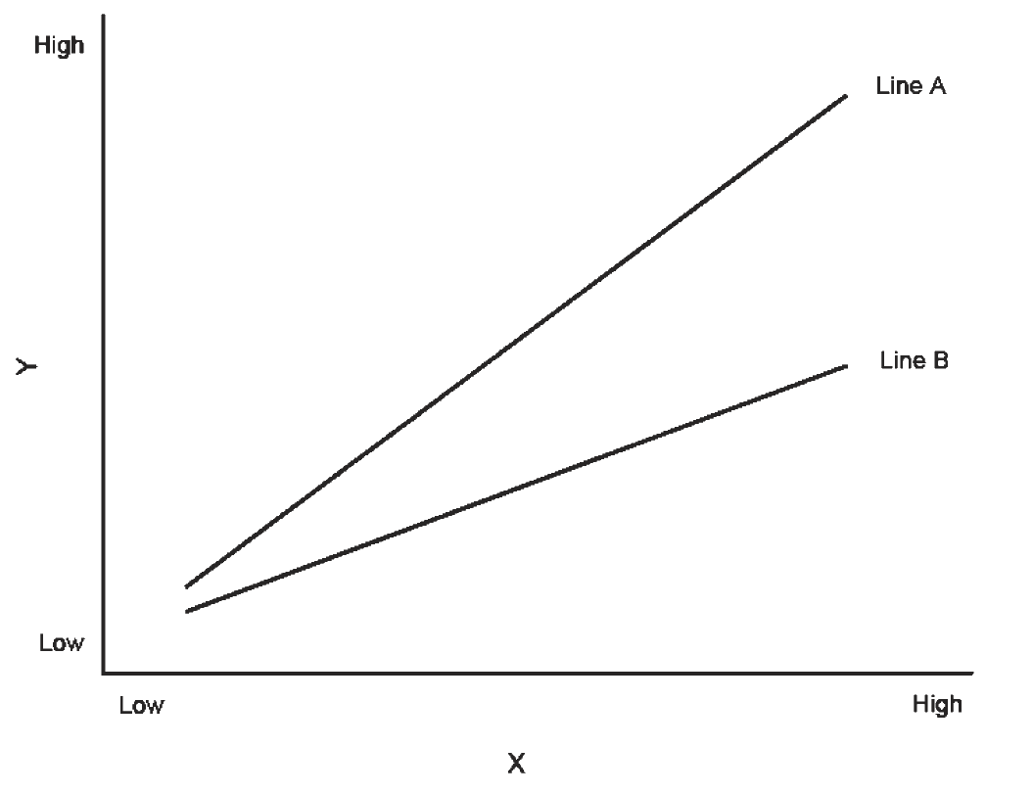
Figure 6.8: Example of Lines with Different Slopes

Slide 13
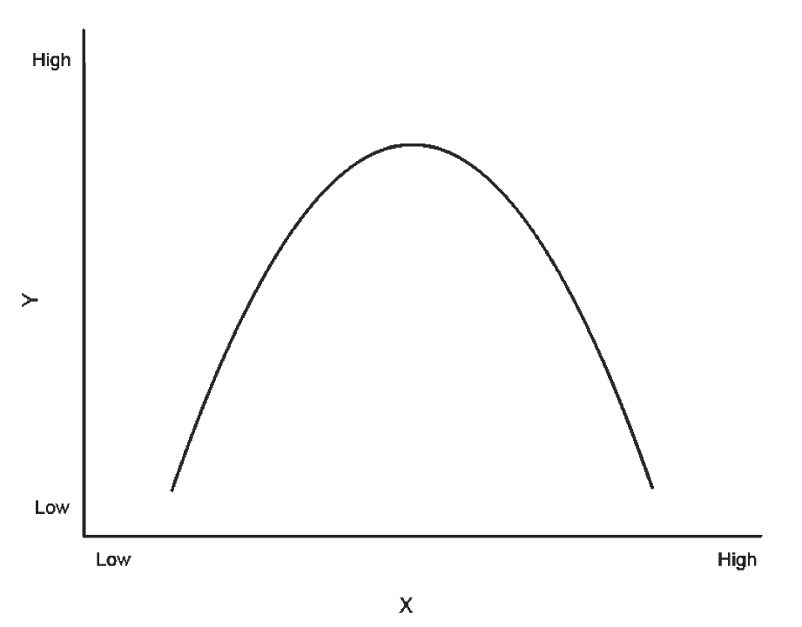
Figure 6.9: Example of Inverted U Function

Slide 14
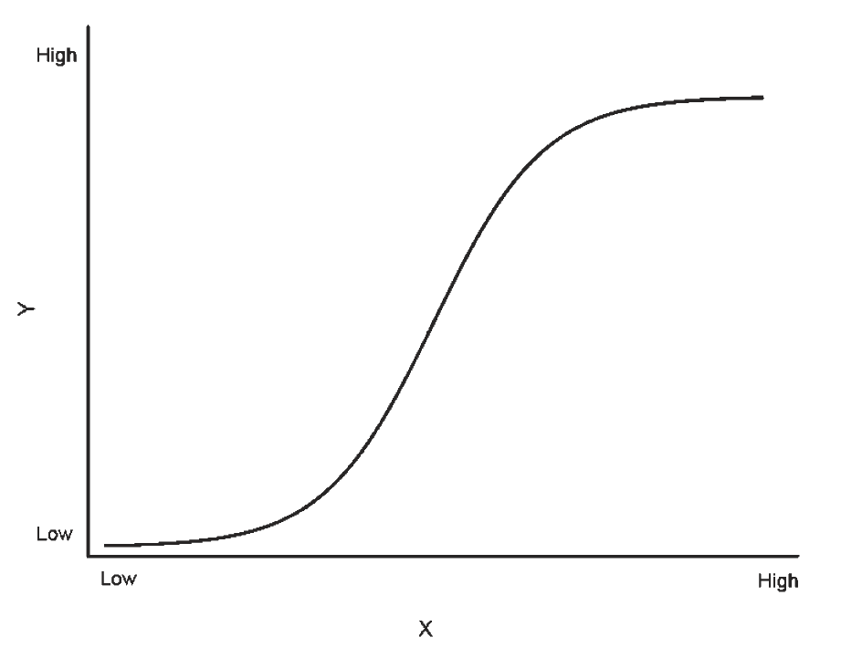
Figure 6.10: S Shaped Function

Slide 15
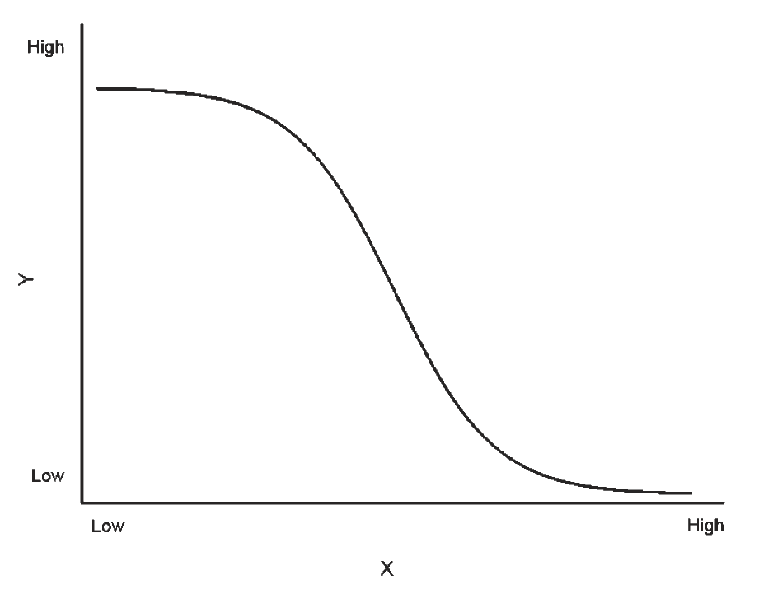
Figure 6.11: Inverse S Shaped Function

Slide 16
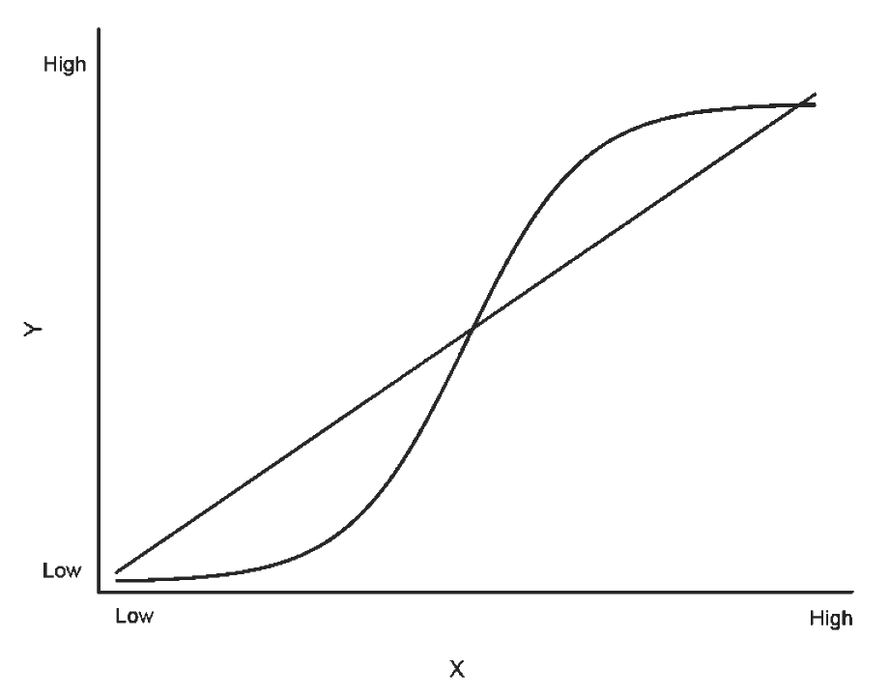
Figure 6.12: Linear and S Shaped Function

Slide 17
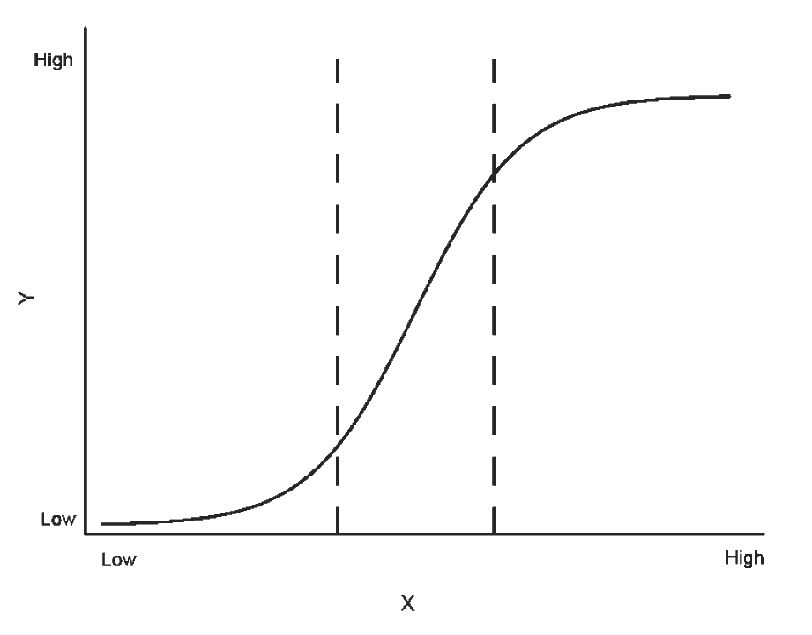
Figure 6.13: Focus on Part of an S Shaped Function

Slide 18
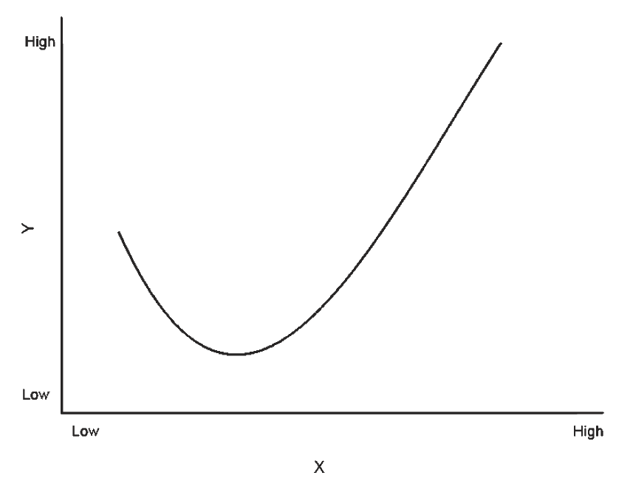
Figure 6.14a: Examples of Non-Linear Functions: J Shaped Function

Slide 19
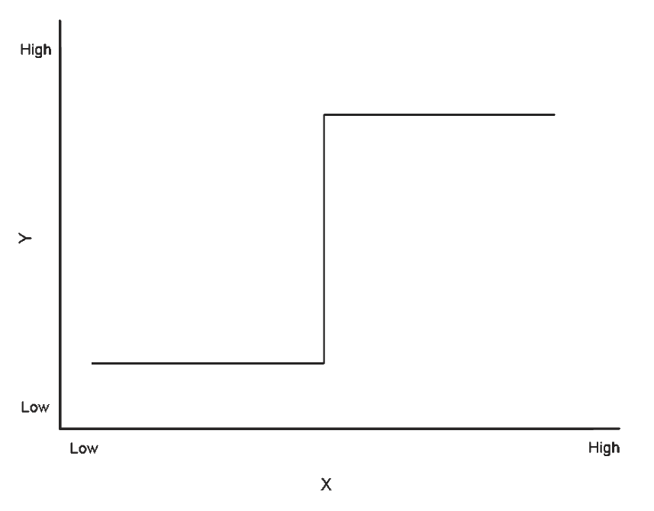
Figure 6.14b: Examples of Non-Linear Functions: Threshold Function

Slide 20
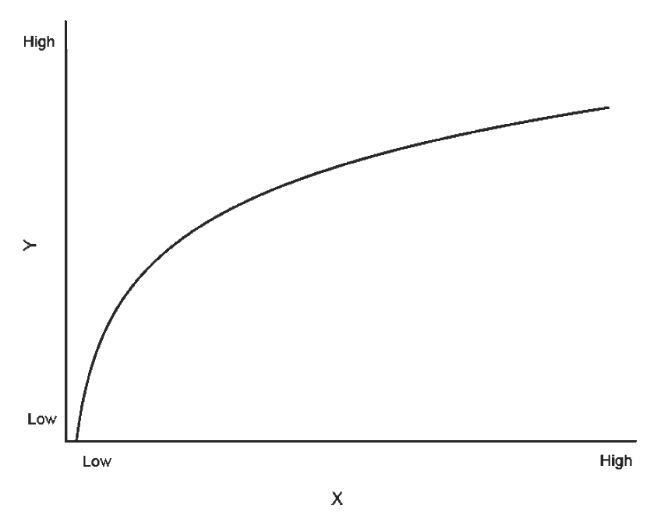
Figure 6.14c: Examples of Non-Linear Functions: Logarithmic Function

Slide 21
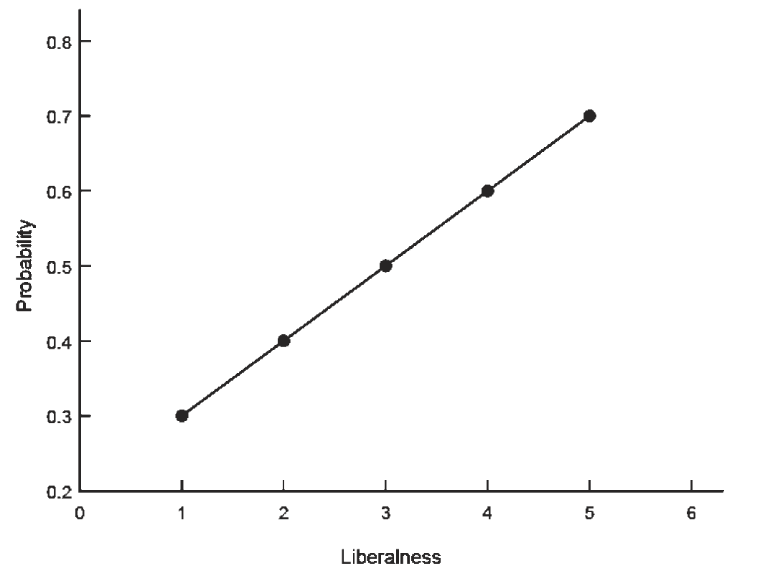
Figure 6.15: Liberalness Example

Slide 22
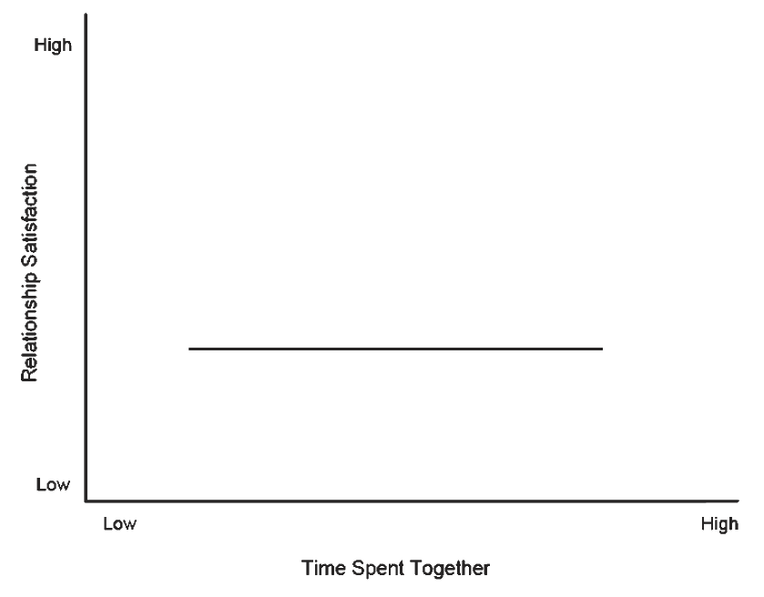
Figure 6.16a: Hypothetical Scatterplots for Moderated Relationship: Males

Slide 23
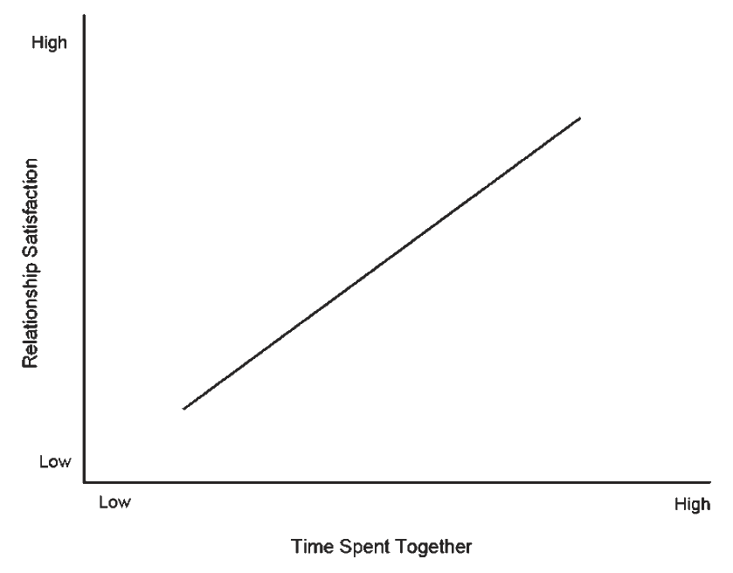
Figure 6.16b: Hypothetical Scatterplots for Moderated Relationship: Females

Slide 24
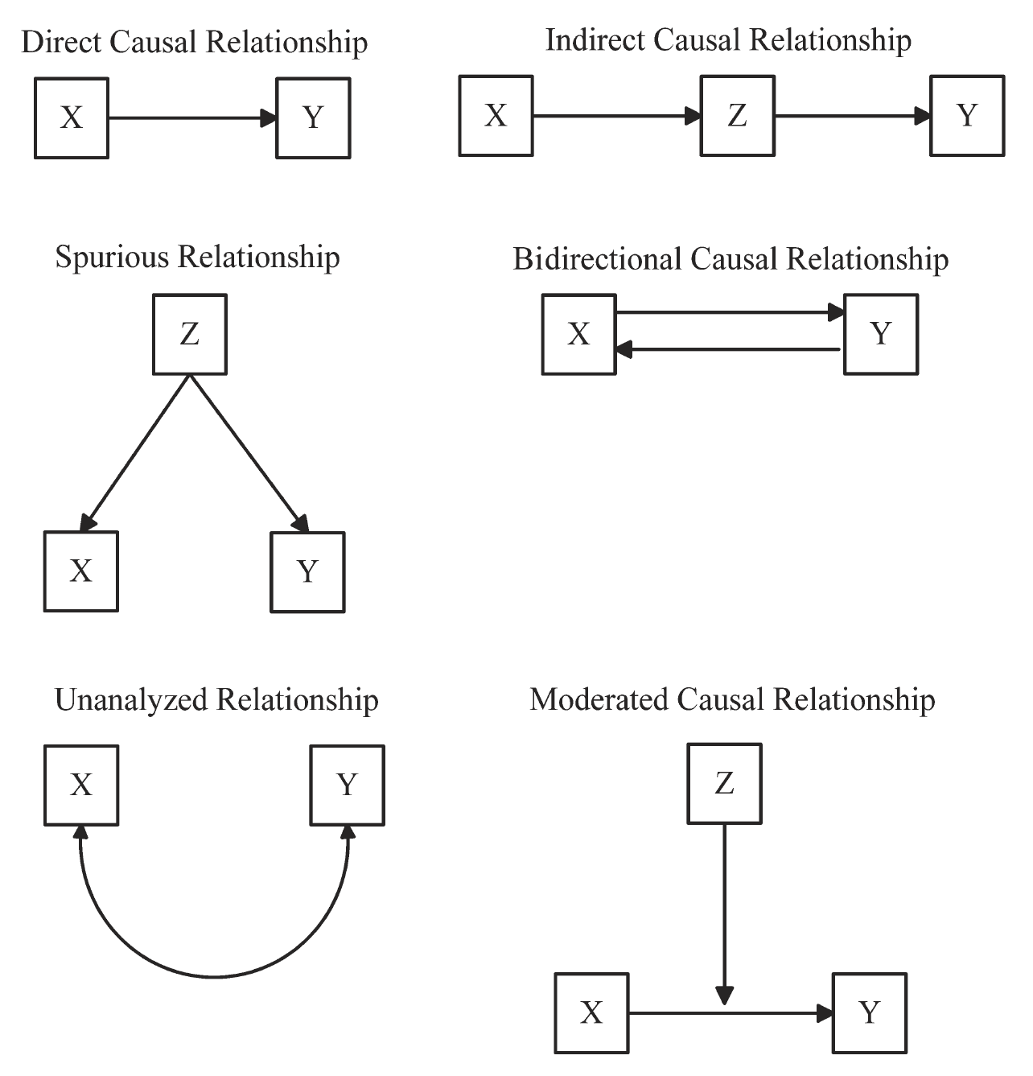
Figure 7.1: Relationships in Causal Models

Slide 25
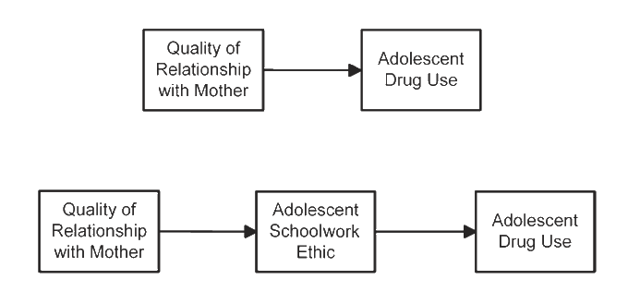
Figure 7.2: Examples of Direct and Indirect Relationships

Slide 26
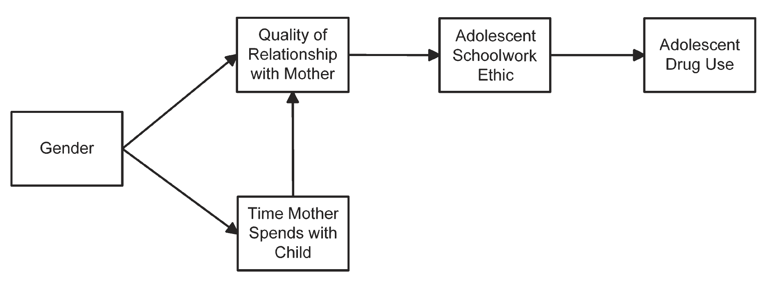
Figure 7.3: Multivariate Causal Model

Slide 27
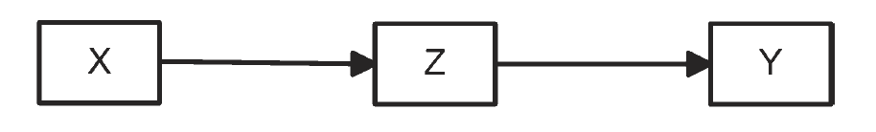
Figure 7.4a: Complete and Partial Mediation: Complete Mediation

Slide 28
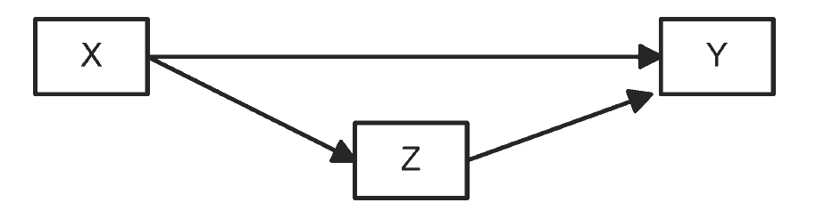
Figure 7.4b: Complete and Partial Mediation: Partial Mediation

Slide 29
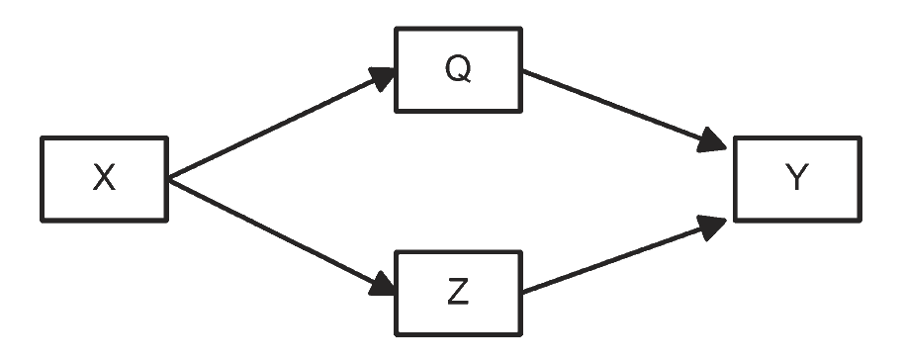
Figure 7.4c: Complete and Partial Mediation: Complete Mediation with Two Mediators

Slide 30
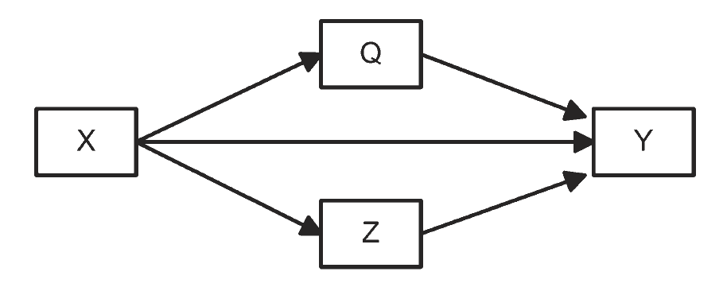
Figure 7.4d: Complete and Partial Mediation: Partial Mediation with Two Mediators

Slide 31
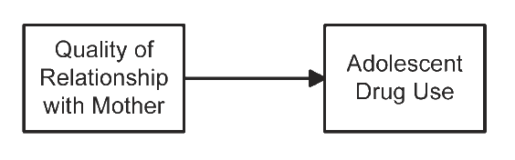
Figure 7.5a: Example of Making the Cause an Outcome: Direct Relationship

Slide 32
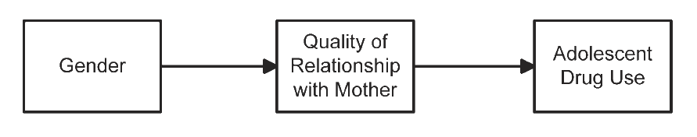
Figure 7.5b: Example of Making the Cause an Outcome: Quality
of Relationship Becomes an Outcome

Slide 33
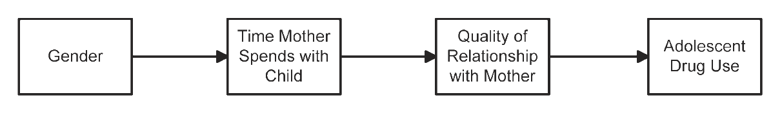
Figure 7.5c: Example of Making the Cause an Outcome: Inserting a Mediator

Slide 34
Figure 7.5d: Example of Making the Cause an Outcome:
Introducing an Effect of an Outcome

Slide 35
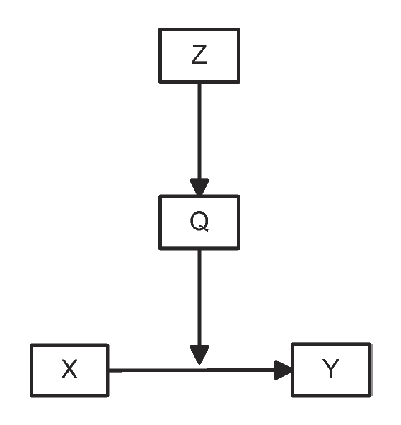
Figure 7.6a: Mediated Moderation: General Mediated Moderation

Slide 36
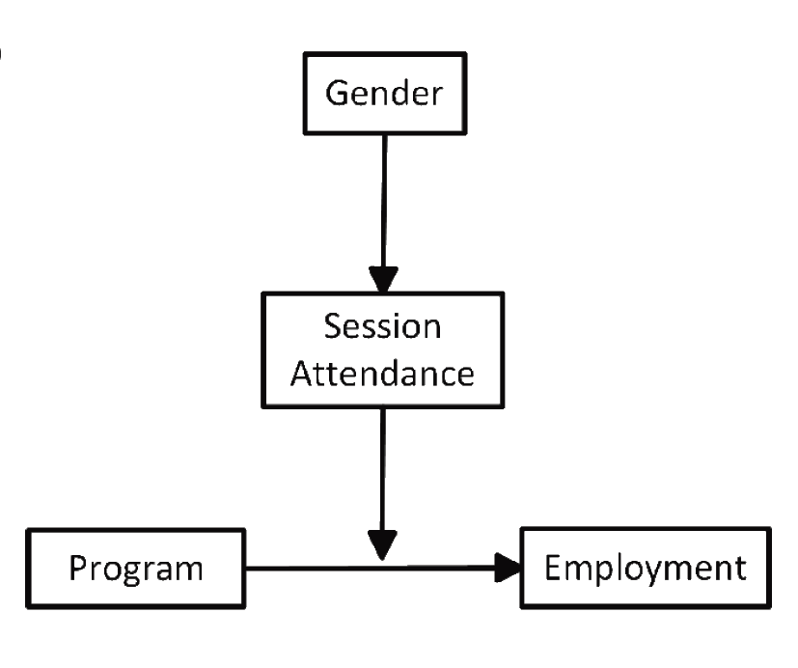
Figure 7.6b: Mediated Moderation: Treatment-Employment Example with Full Mediation

Slide 37
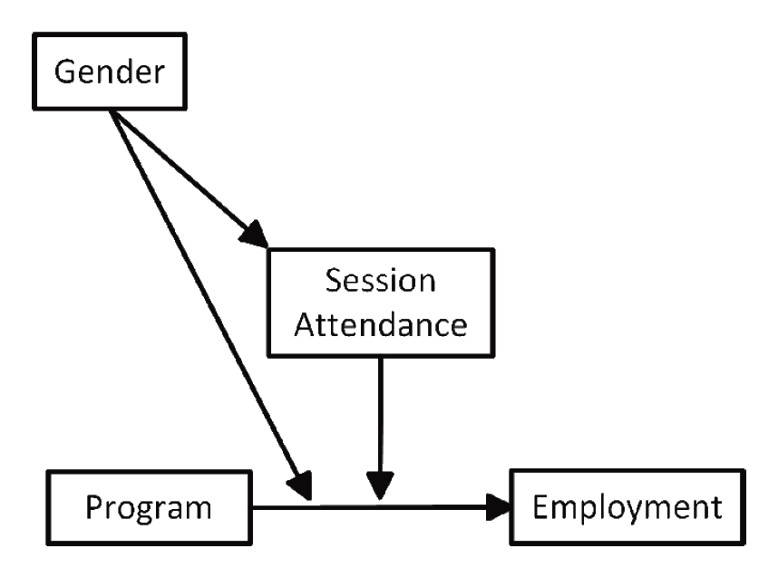
Figure 7.6c: Mediated Moderation: Treatment-Employment Example with Partial Mediation

Slide 38
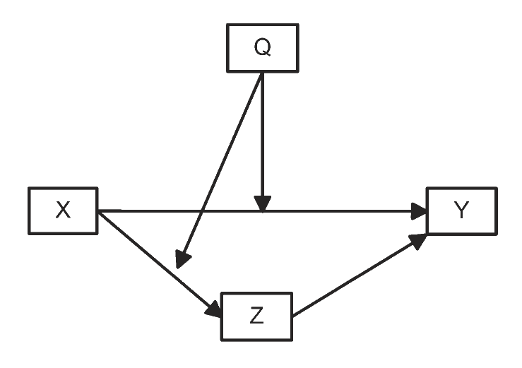
Figure 7.7a: Moderated Mediation: General Moderated Mediation

Slide 39
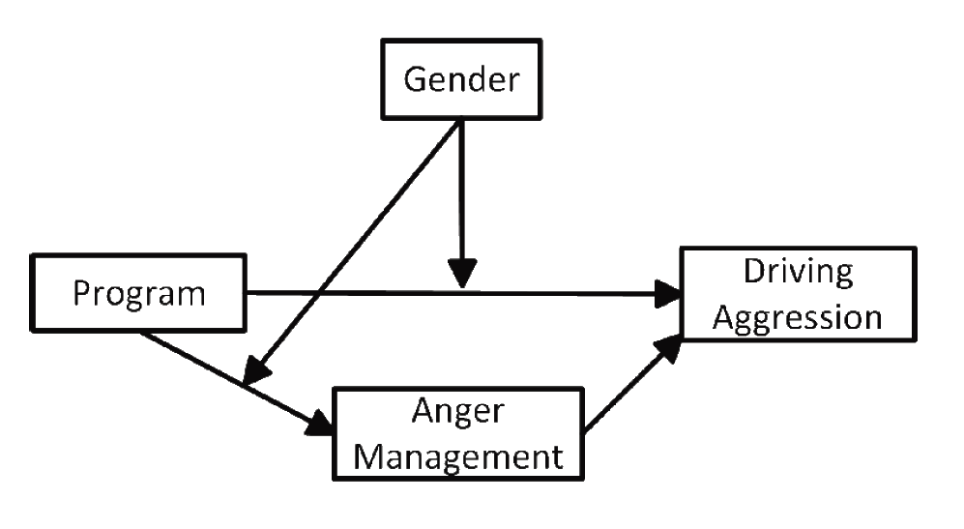
Figure 7.7b: Moderated Mediation: Treatment-Drivin Aggression
Example of Moderated Mediation

Slide 40
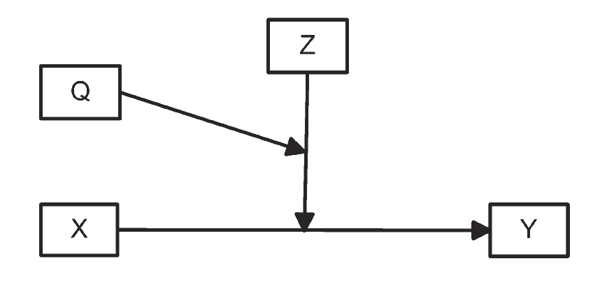
Figure 7.8a: Moderated Moderation: General Moderated Moderation

Slide 41
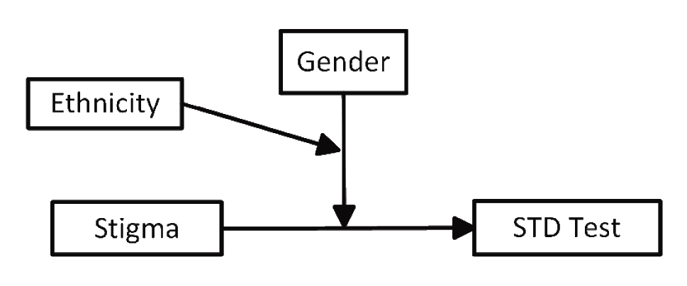
Figure 7.8b: Moderated Moderation: Stigma-STD Example of Moderated Moderation

Slide 42
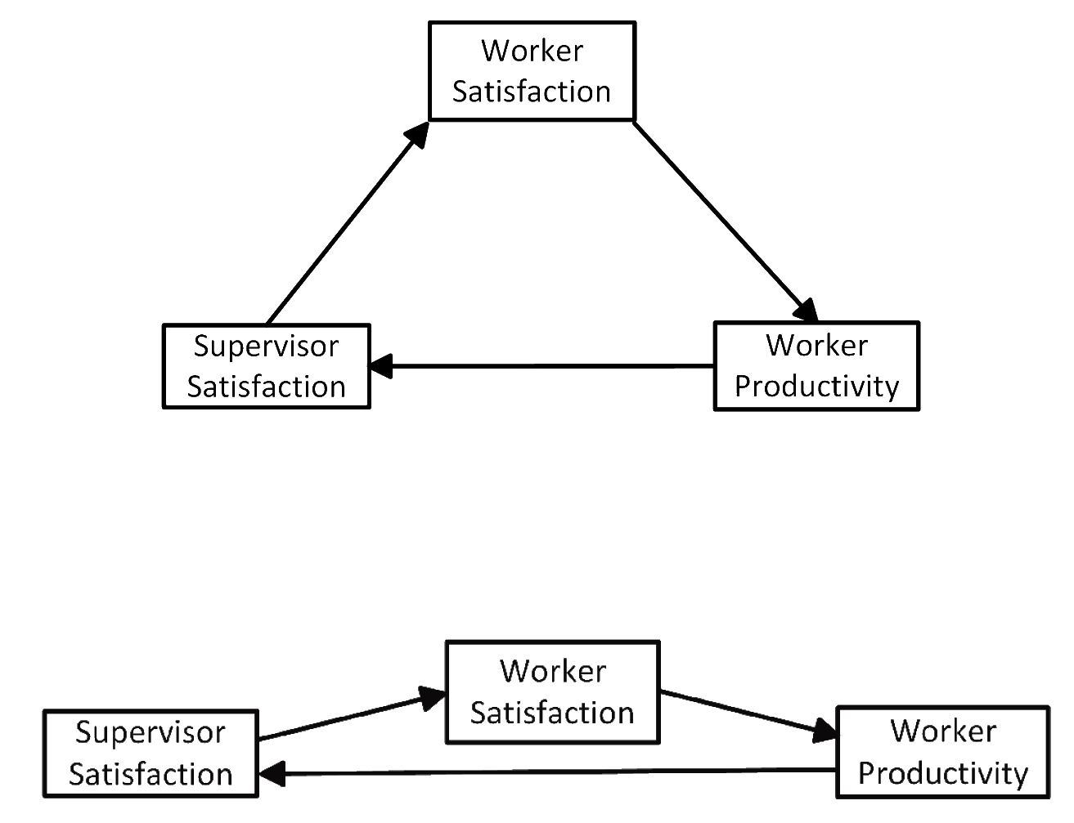
Figure 7.9: Feeback Loops as Reciprocal Causation

Slide 43
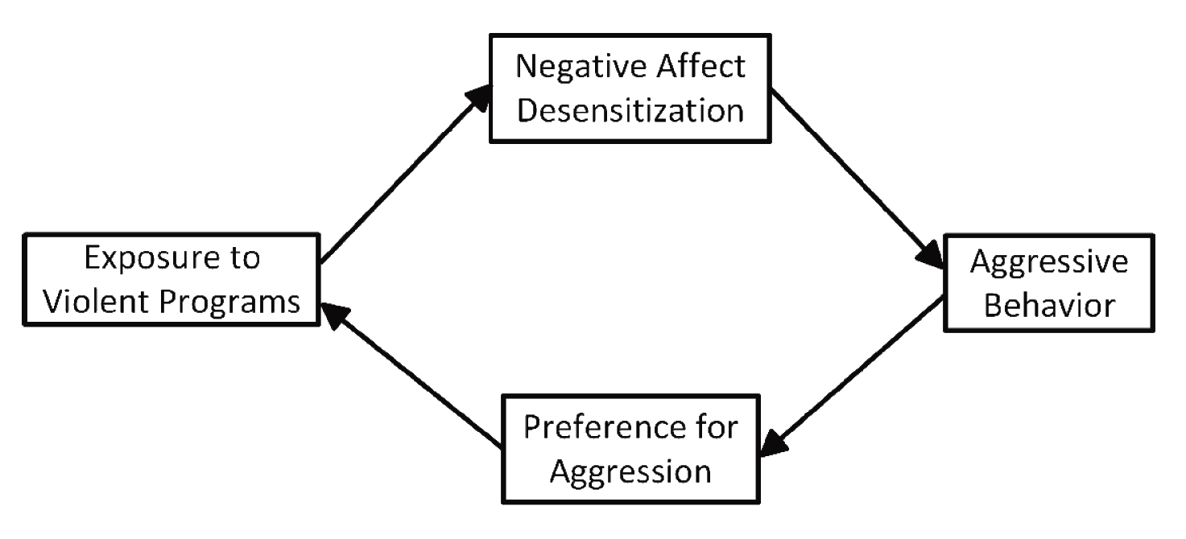
Figure 7.10a: Feedback Loop with Two Mediators: Complete Mediation

Slide 44
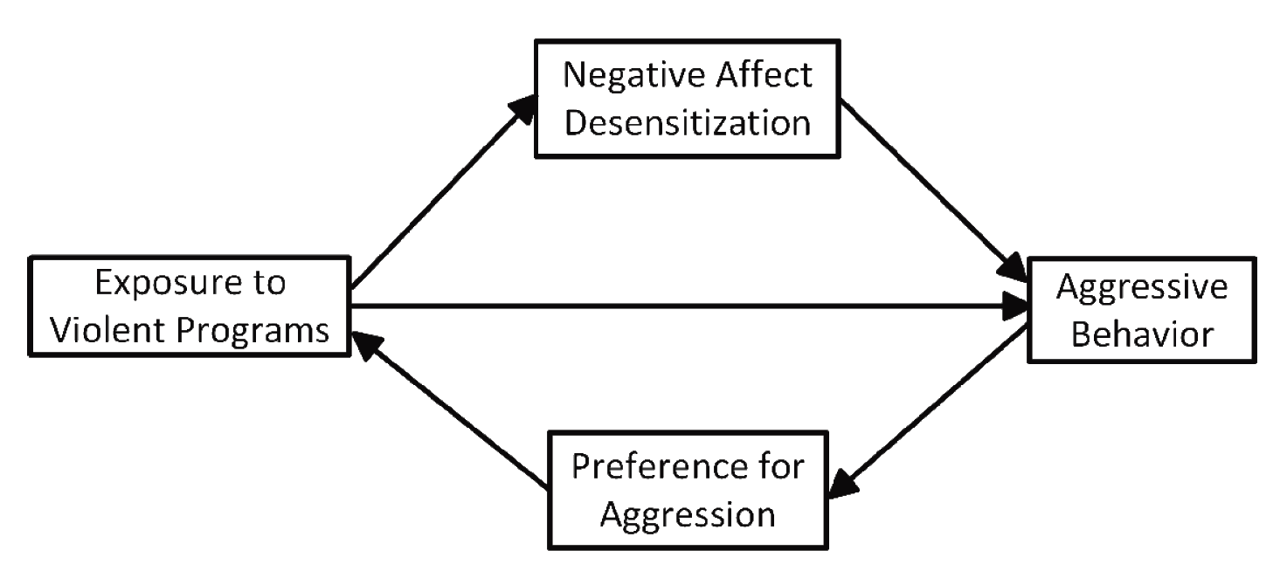
Figure 7.10a: Feedback Loop with Two Mediators: Partial Mediation

Slide 45
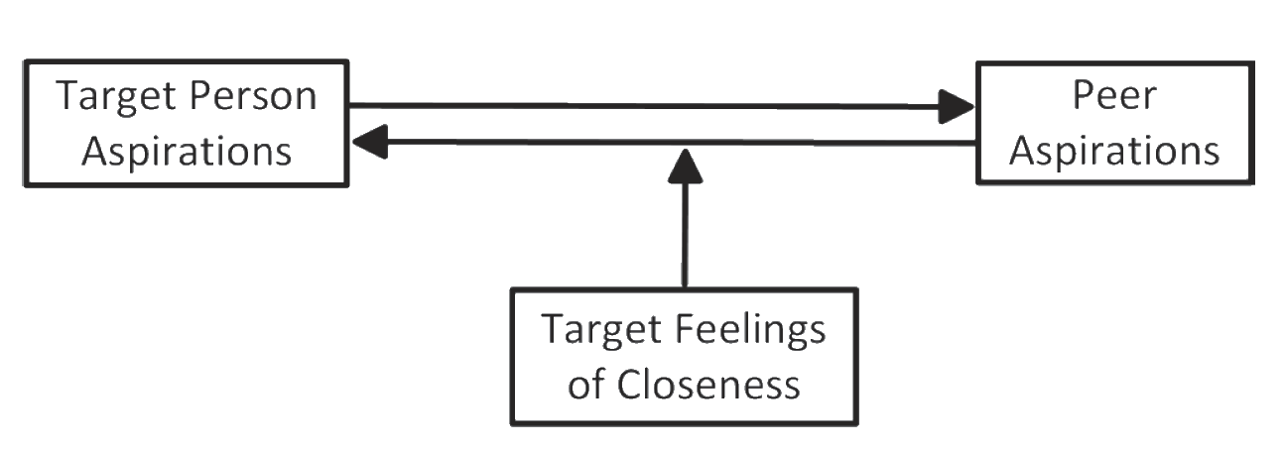
Figure 7.11a: Moderated Reciprocal Causation: One Moderator Model

Slide 46
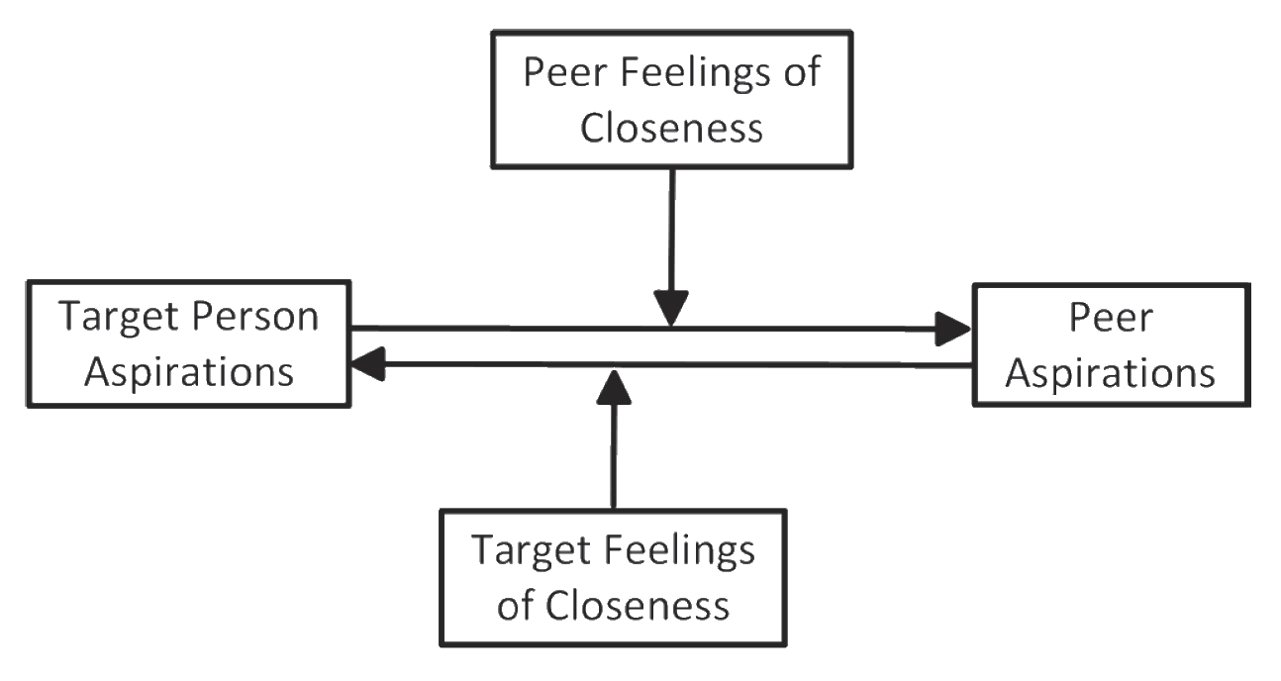
Figure 7.11b: Moderated Reciprocal Causation: Two Moderator Model

Slide 47
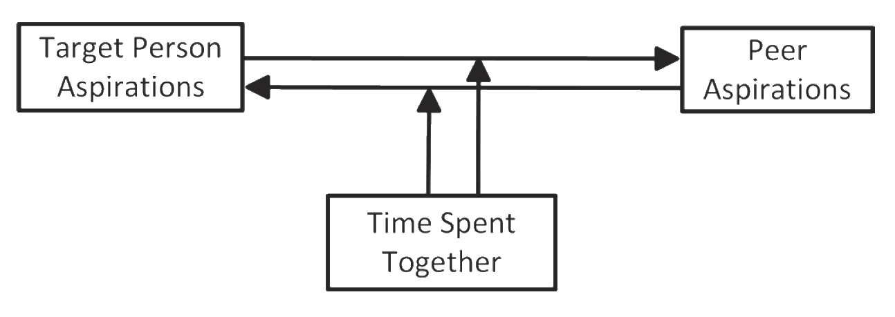
Figure 7.11c: Moderated Reciprocal Causation: One Moderator
Variable, Two Moderated Relationships

Slide 48
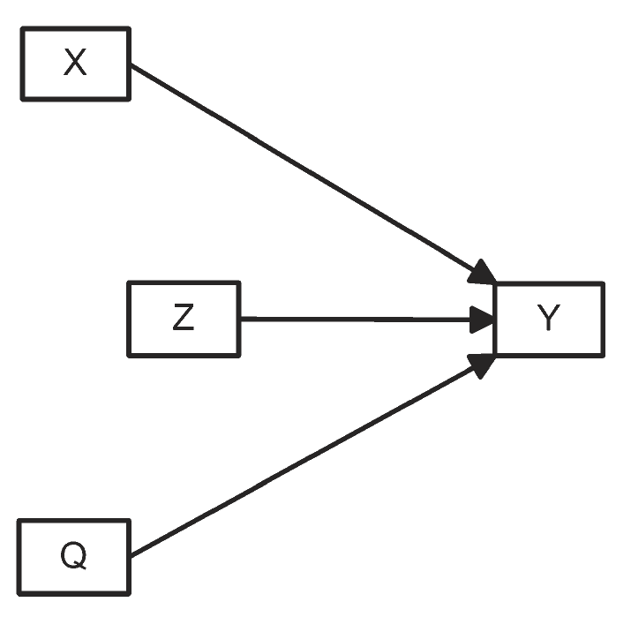
Figure 7.12a: Mapping Causal Relationships Among All Variables: Original Specification

Slide 49
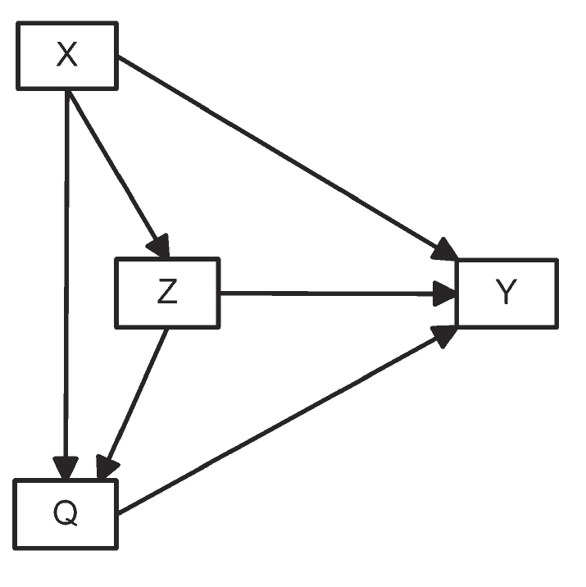
Figure 7.12b: Mapping Causal Relationships Among All Variables: Mapped Specification

Slide 50
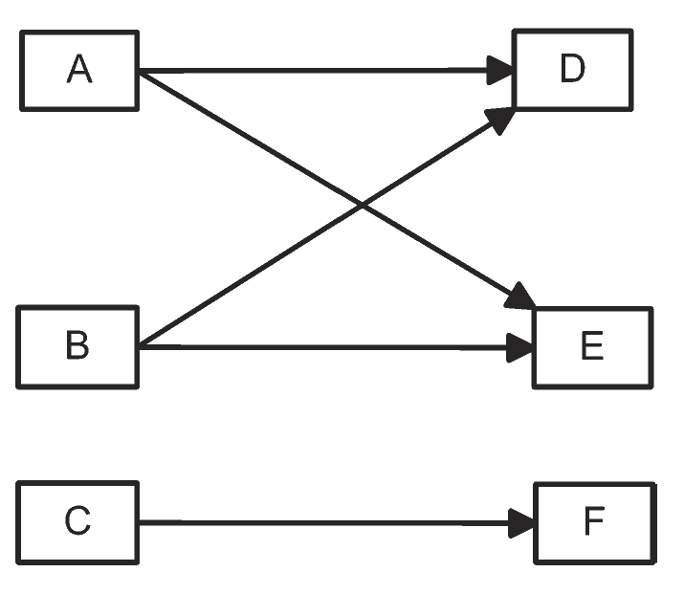
Figure 7.13a: Example of Exogenous and Endogenous Variables: Three
Exogenous and Three Endogenous Variables

Slide 51
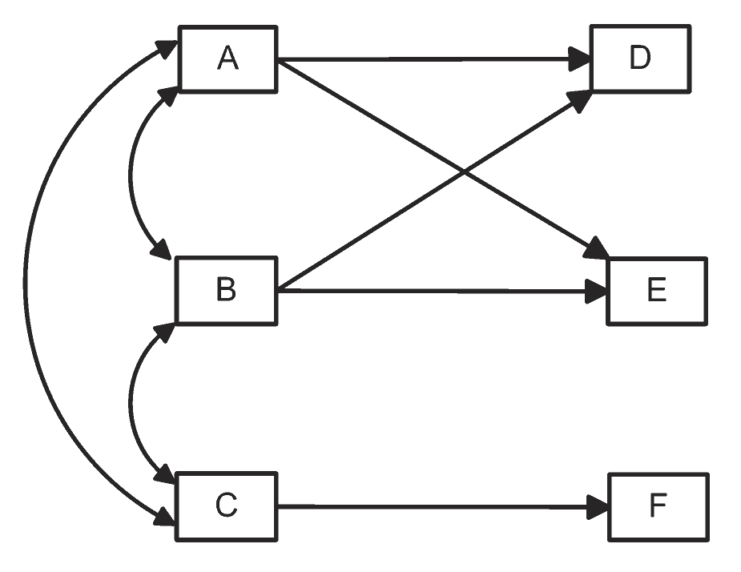
Figure 7.13b: Example of Exogenous and Endogenous Variables: Unanalyzed
Relationships between Exogenous Variables

Slide 52
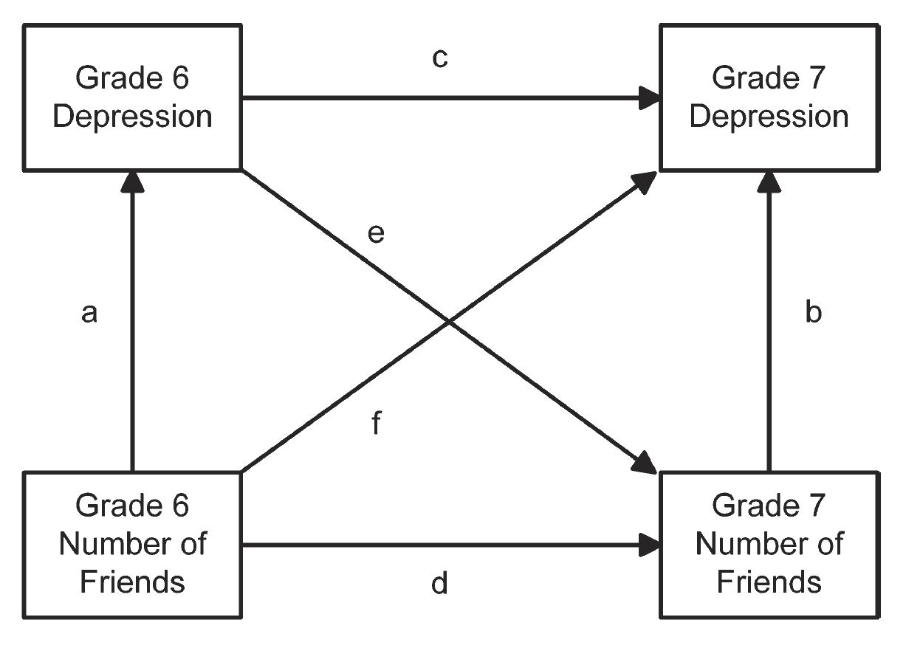
Figure 7.14: Models with Temporal Dynamics: Theory with Two Time Points

Slide 53

Figure 7.15: Three Wave Theory

Slide 54

Figure 7.16a: Examples of Disturbance Terms: Theory with Disturbance Term

Slide 55

Figure 7.16b: Examples of Disturbance Terms: Smoking and Drug Example
with Uncorrelated Disturbance Terms

Slide 56

Figure 7.16c: Examples of Disturbance Terms: Smoking and Drug Example
with Correlated Disturbance Terms

Slide 57

Figure 7.17: Example of Correlated Disturbances in a Longitudinal Model

Slide 58

Figure 7.18: Measurement Models

Slide 59

Figure 7.19: Example of Integrated Structural and Measurement Model

Slide 60

Figure 8.1: Linear Relationship with Slope = 1

Slide 61

Figure 8.2: Examples of Linear Relationships with Different Slopes or Intercepts

Slide 62

Figure 8.3: Example of a Negative Slope

Slide 63

Figure 8.4: Non-Linear Relationship for Derivative Example

Slide 64

Figure 8.5: Area under the Curve for a Standardized Normal Distribution

Slide 65

Figure 8.6a: Graphs of Log Functions for log_{a}(X), with X Ranging from 1 to 100: a > 1

Slide 66

Figure 8.6b: Graphs of Log Functions for log_{a}(X), with X Ranging from 1 to 100: 0 < a < 1

Slide 67

Figure 8.7a: Graphs of Exponential Functions for a^{X}, with X Ranging from 1 to 5: a > 1

Slide 68

Figure 8.8: Exponential Growth for Y = s₀ e^{(kX)}

Slide 69

Figure 8.9: Graphs of Power Functions for Xª, with X Ranging from 1 to 5: a > 1

Slide 70

Figure 8.9: Graphs of Power Functions for Xª, with X Ranging from 1 to 5: 0 < a < 1

Slide 71

Figure 8.9: Graphs of Power Functions for Xª, with X Ranging from 1 to 5: a < 0

Slide 72

Figure 8.10: Example of Power and Exponential Functions

Slide 73

Figure 8.11a: Quadratic Functions: Function c + bX + aX², with c = 0, b = .5

Slide 74

Figure 8.11b: Quadratic Functions: Function c + bX + aX², with c = 0, b = -1

Slide 75

Figure 8.12a: Cubic functions: Function for a + bX + cX² + dX³

Slide 76

Figure 8.12b: Cubic functions: Additional Functions for a + bX + cX² + dX³

Slide 77

Figure 8.13: Polynomial Dunction with Seven Terms

Slide 78

Figure 8.14: Sine Function

Slide 79

Figure 8.15: Graphical Representation of a Function with a Qualitative Variable

Slide 80

Figure 8.16a: Exponential and Bounded Exponential Model: Exponential Function

Slide 81

Figure 8.16b: Exponential and Bounded Exponential Model: Bounded Exponential Function

Slide 82

Figure 8.17: Logistic Function

Slide 83

Figure 8.18: Example for Performance = Ability × Motivation

Slide 84

Figure 8.19: Fishbein and Ajzen Model for Probability of Acceptance

Slide 85

Figure 8.20: Chaos Theory Example

Slide 86

Figure 10.1: Tree Diagram of Category Levels

Slide 87

Figure 10.2: Conventional Symbols for a Process Map

Slide 88

Figure 10.3: Theory of Determinants of Husband Abuse

Slide 89

Figure 11.1: SPSS Scatterplot

Slide 90

Figure 11.2: Scatterplot with Smoother

Slide 91

Figure 11.3: Binary Outcome Smoother

Slide 92

Figure 11.4: Plot of Two Distributions with Equal Means but Different Deciles

Slide 93

Figure 11.5: Time Pressures and Quality of Work

Slide 94

Figure 11.6: Cluster Plot

Slide 95

Figure 11.B.1: Cohen’s d for Two Examples

Slide 96

Figure 12.1: A Neural Network

Slide 97

Figure 12.2a: Examples for Multilevel Modeling: Level 1 Analysis

Slide 98

Figure 12.2b: Examples for Multilevel Modeling: Multi-Level Model

Slide 99

Figure 12.2c: Examples for Multilevel Modeling: Multi-Level Model with Moderation

Slide 100

Figure 12.3: Example of the Analysis of Behavioral Trajectories

Slide 101

Figure 13.1: Classic Test Theory: Brief Version

Slide 102

Figure 13.1: Classic Test Theory: Theory Construction Version

Slide 103

Figure 13.2: Augmented Diagram for Random Error

Slide 104

Figure 14.1: Factors Influencing Comprehension

Slide 105

Figure 14.2: Factors Impacting Response Translation

Slide 106

Figure 15.1: Societal Differences in Visual Perception

Slide 107

Figure 15.2: Model of School Performance

Slide 108

Figure 15.3: Model of School Performance with Coefficients

Slide 109

Figure 15.4: Modified Model

Slide 110

Figure 15.5: Birthweight, Smoking and Alcohol Example

Slide 111

Figure 16.1a: Causal Models Underlying Statistical Tests: Two-Group/Condition t-Test

Slide 112

Figure 16.1b: Causal Models Underlying Statistical Tests: One-Way Analysis of Variance

Slide 113

Figure 16.1c: Causal Models Underlying Statistical Tests: Chi-square
Test of Independence and Test of Proportions

Slide 114

Figure 16.1d: Causal Models Underlying Statistical Tests: Pearson Correlation/Linear Regression - Direct Cause Model

Slide 115

Figure 16.1e: Causal Models Underlying Statistical Tests: Pearson Correlation –
Common Cause or Spurious Effect Model

Slide 116

Figure 16.1f: Causal Models Underlying Statistical Tests:
Two-Factor Analysis of Variance

Slide 117
Figure 16.1g: Causal Models Underlying Statistical Tests: One-way Analysis
of Covariance - Mediation

Slide 118

Figure 16.1h: Causal Models Underlying Statistical Tests: One-way Analysis of Covariance -
Independent Influence and Error Reduction;

Slide 119
Figure 16.1i: Causal Models Underlying Statistical Tests: Partial Correlation - Mediation

Slide 120

Figure 16.1j: Causal Models Underlying Statistical Tests: Partial Correlation –
Common Cause or Spurious Effect Model

Slide 121

Figure 16.1k: Causal Models Underlying Statistical Tests: Multiple Regression

Slide 122

Figure 16.1l: Causal Models Underlying Statistical Tests: Mediation Based
Hierarchical Multiple Regression

